Slide 1
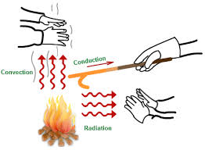
The Transfer of Heat
Heat is transferred by conduction, convection, and radiation.

Slide 2
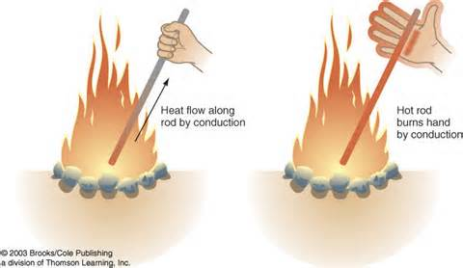
How is Heat Transferred
In the process of conduction, heat is transferred from one particle of matter to another without the movement of the matter.
    Ex. Metal spoon in a pot of water on an electric stove
    Fast-moving particles in the water transfer heat as they collide with the slow-moving particles in the spoon. Eventually the heat conducts through the spoon and to your hand.

Slide 3
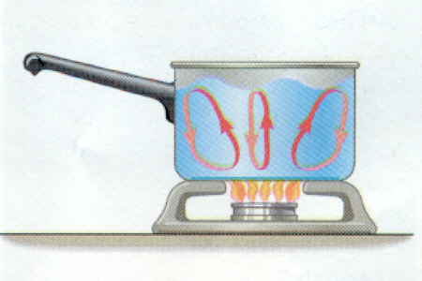
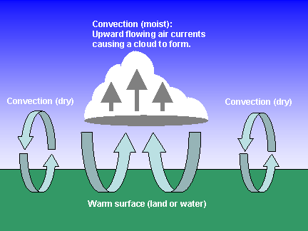
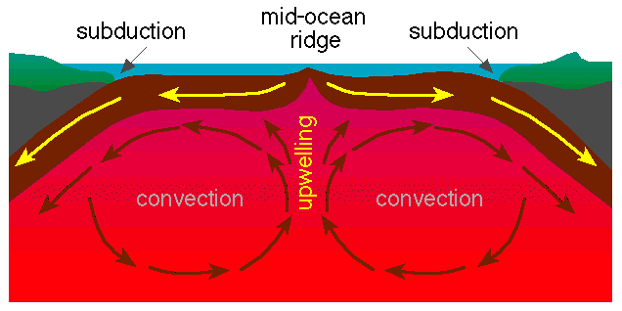
How is Heat Transferred
In convection, heat is transferred by the movement of currents within a fluid.
When the water at the bottom of the pot is heated, its particles move faster. The particles also move farther apart and become less dense. The heated water will then rise, and the cooler water flows into its place.
This flow creates a circular motion known as a convection current.

Slide 4
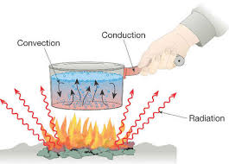
Convection and Convection Currents

Slide 5
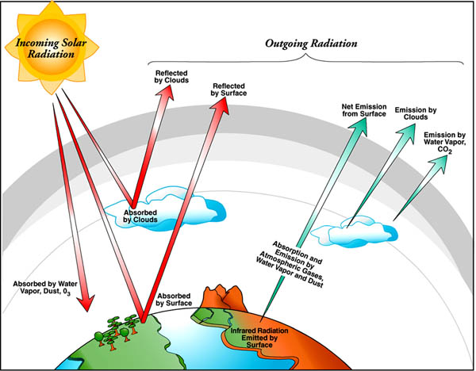
How is Heat Transferred
Radiation is the transfer of energy by electromagnetic waves.
Unlike conduction and convection, radiation does not require matter to transfer thermal energy.
  Ex. Heat from the sun
All of the sun’s energy that reaches Earth travels through millions of kilometers of empty space

Slide 6
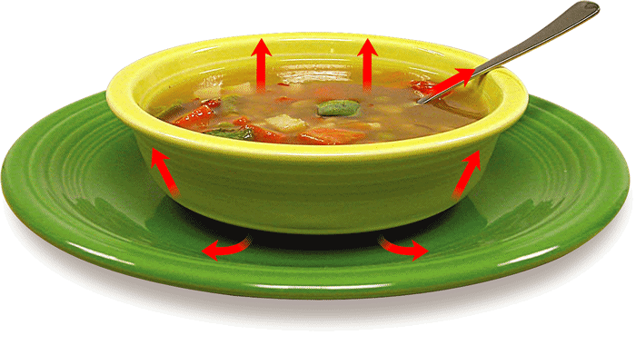
Heat Moves One Way
- The Transfer of Heat
If two objects have different temperatures, heat will flow from the warmer object to the colder one.

Slide 7
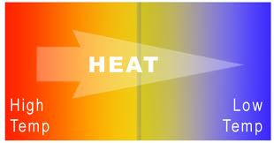
Heat Moves One Way
When heat flows into matter, the thermal energy of the matter increases
As thermal energy increases, the temperature increases
Heat will flow from one object to the other until the two objects have the same temperature
  Ex. Hot soup cooling to room temperature

Slide 8
Graphic Organizer
Heat
is the transfer of
by

Slide 9
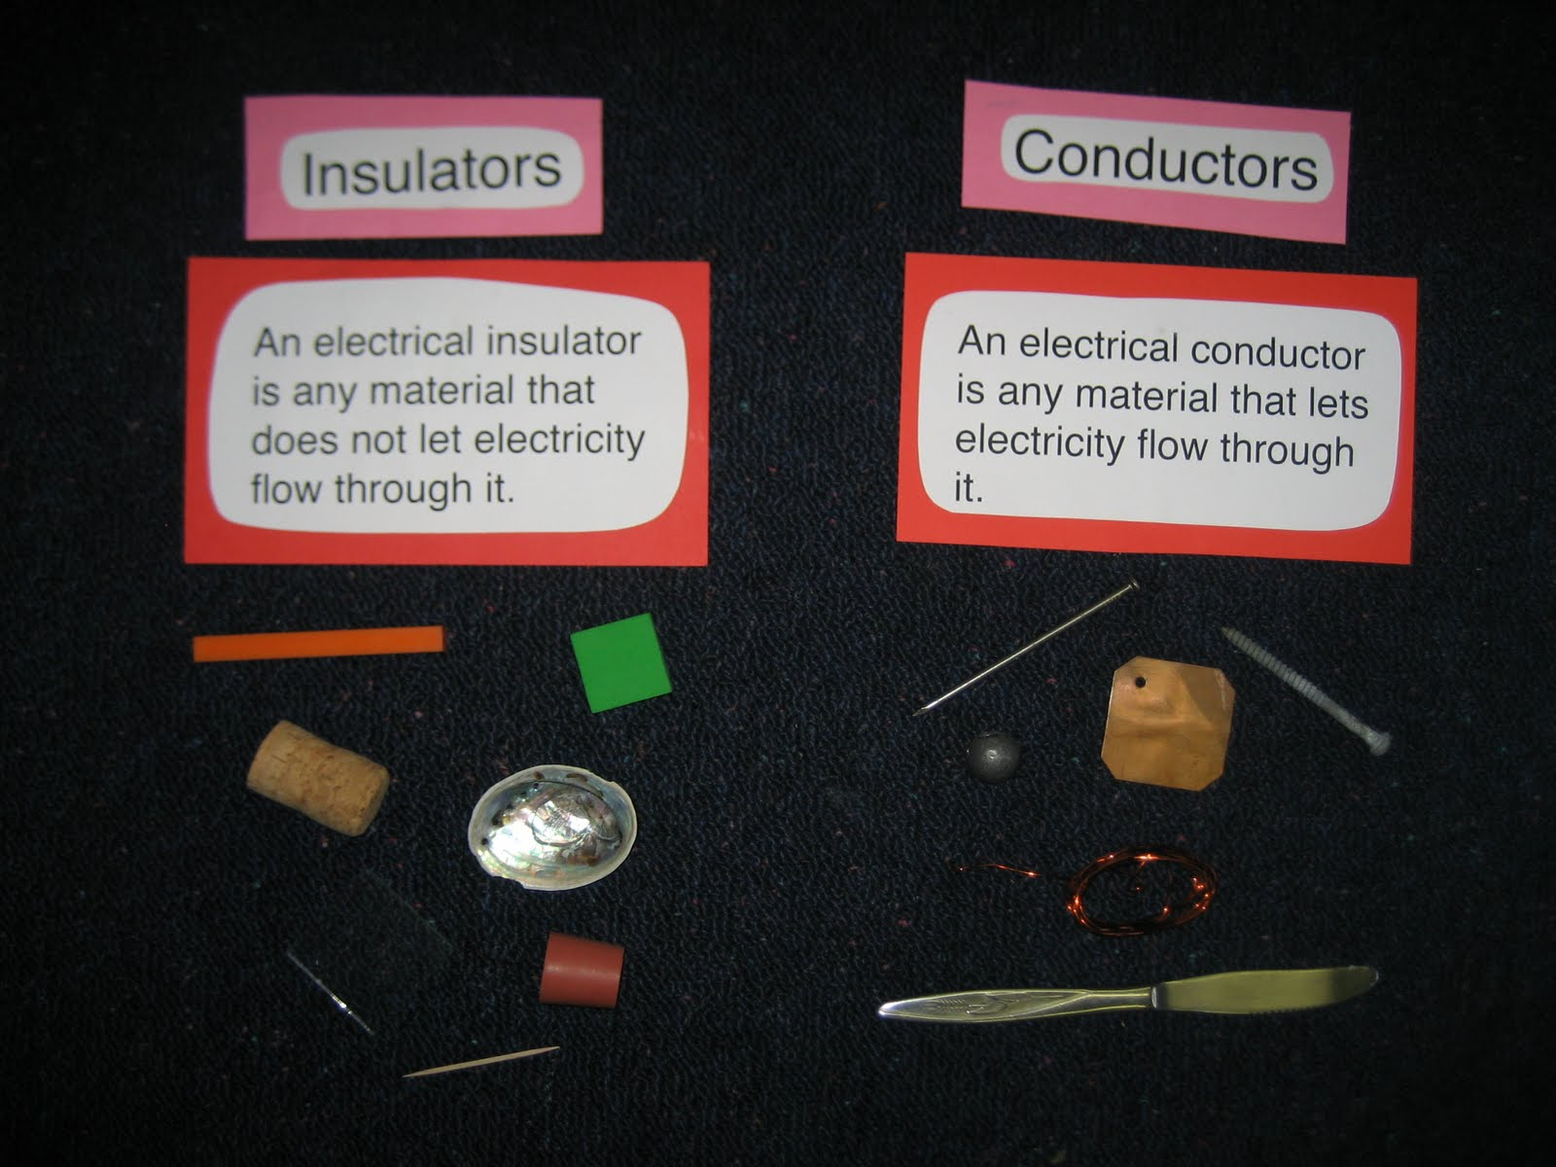
Conductors and Insulators
A material can be either a conductor or an insulator
A conductor transfers thermal energy well. An insulator does not transfer thermal energy well.
What materials do you think would be considered a conductor?
What materials do you think would be considered an insulator?

Slide 10
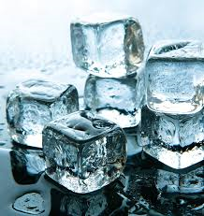
Heat Moves One Way
Ice does not transfer cold to other materials
There is no such thing as “coldness”
Heat transfer occurs in only one direction
Heat transferring to ice will melt the ice

Slide 11
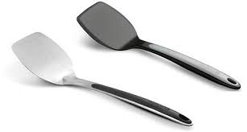
Conductors and Insulators
A metal spatula would transfer heat better than a plastic spatula
A material that conducts heat well is called a conductor
Ex. Metals such as silver and stainless steel
Good conductors, such as a tile floor, feel cool to the touch because it easily transfers heat away from your skin

Slide 12

Conductors and Insulators
A material that does not conduct heat well is called an insulator
  Ex. Wood, wool, paper, and gases in the air
Clothes and blankets are insulators that slow the transfer of heat out of your body
Insulation in a building prevents heat from entering the building in hot weather and from escaping in cold weather.

Slide 13
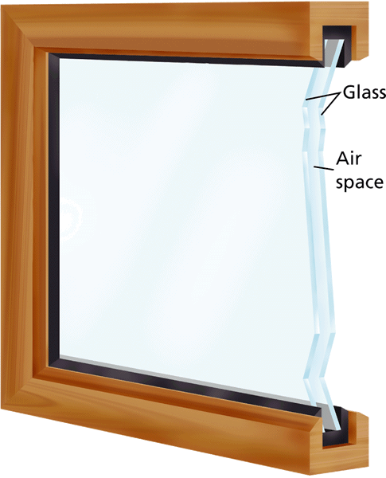
Insulators
- The Transfer of Heat
Air between the panes of this window acts as an insulator to slow the transfer of heat.

